Slide 1

Team Phantom Systems 101
By Zainab Vajahath

Slide 2
Topics
Electrical Car Systems
Mechanical Systems
Real Time Embedded Systems

Slide 3
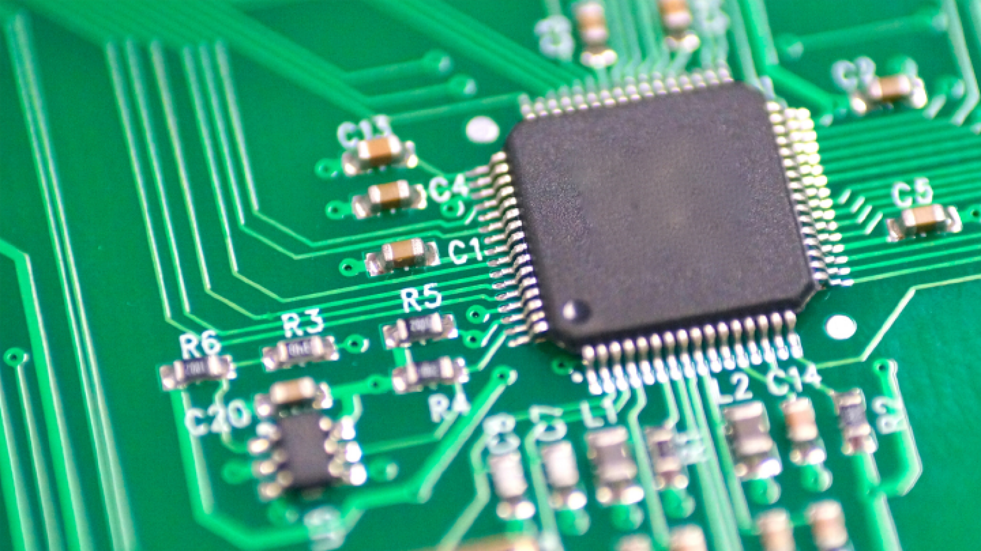
Electrical Team
Batteries
Motors
Circuit design
PCB layout
Prototyping

Slide 4
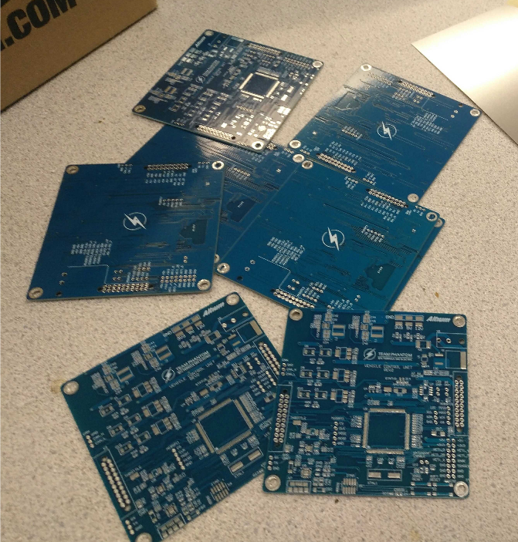
PCB’s - Printed Circuit Boards
Each PCB is designed using altium software
We use Github to collaborate on boards
PCB’s can be made for both high and low voltage systems
Our boards are typically 100x100mm max
Iterative design process

Slide 5
High and Low Voltage
High Voltage:
Max of 600V DC (EV.1.3.2)
Relates to all battery systems
Consists of 12+ PCBs
Must have an isolated ground from the Low voltage (LV) system
Lots of safety precautions!
Low Voltage:
Not as many boards as HV
Grounded to the chassis (it will not kill the driver, don’t worry!)
Relates to smaller systems
BSPD (brake systems plausibility device)
TSAL (tractive system active light)

Slide 6
Activity: Does the accumulator box hold high or low voltage systems?
(Hint: Search through the FSAE competition rules)

Slide 7
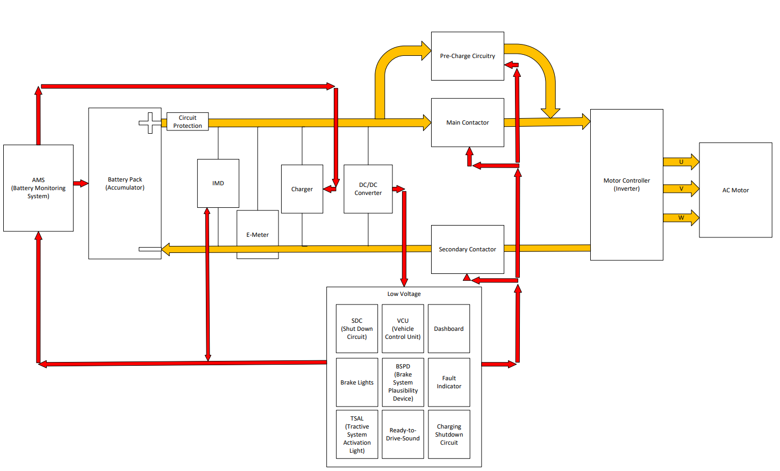
High Level Diagram

Slide 8
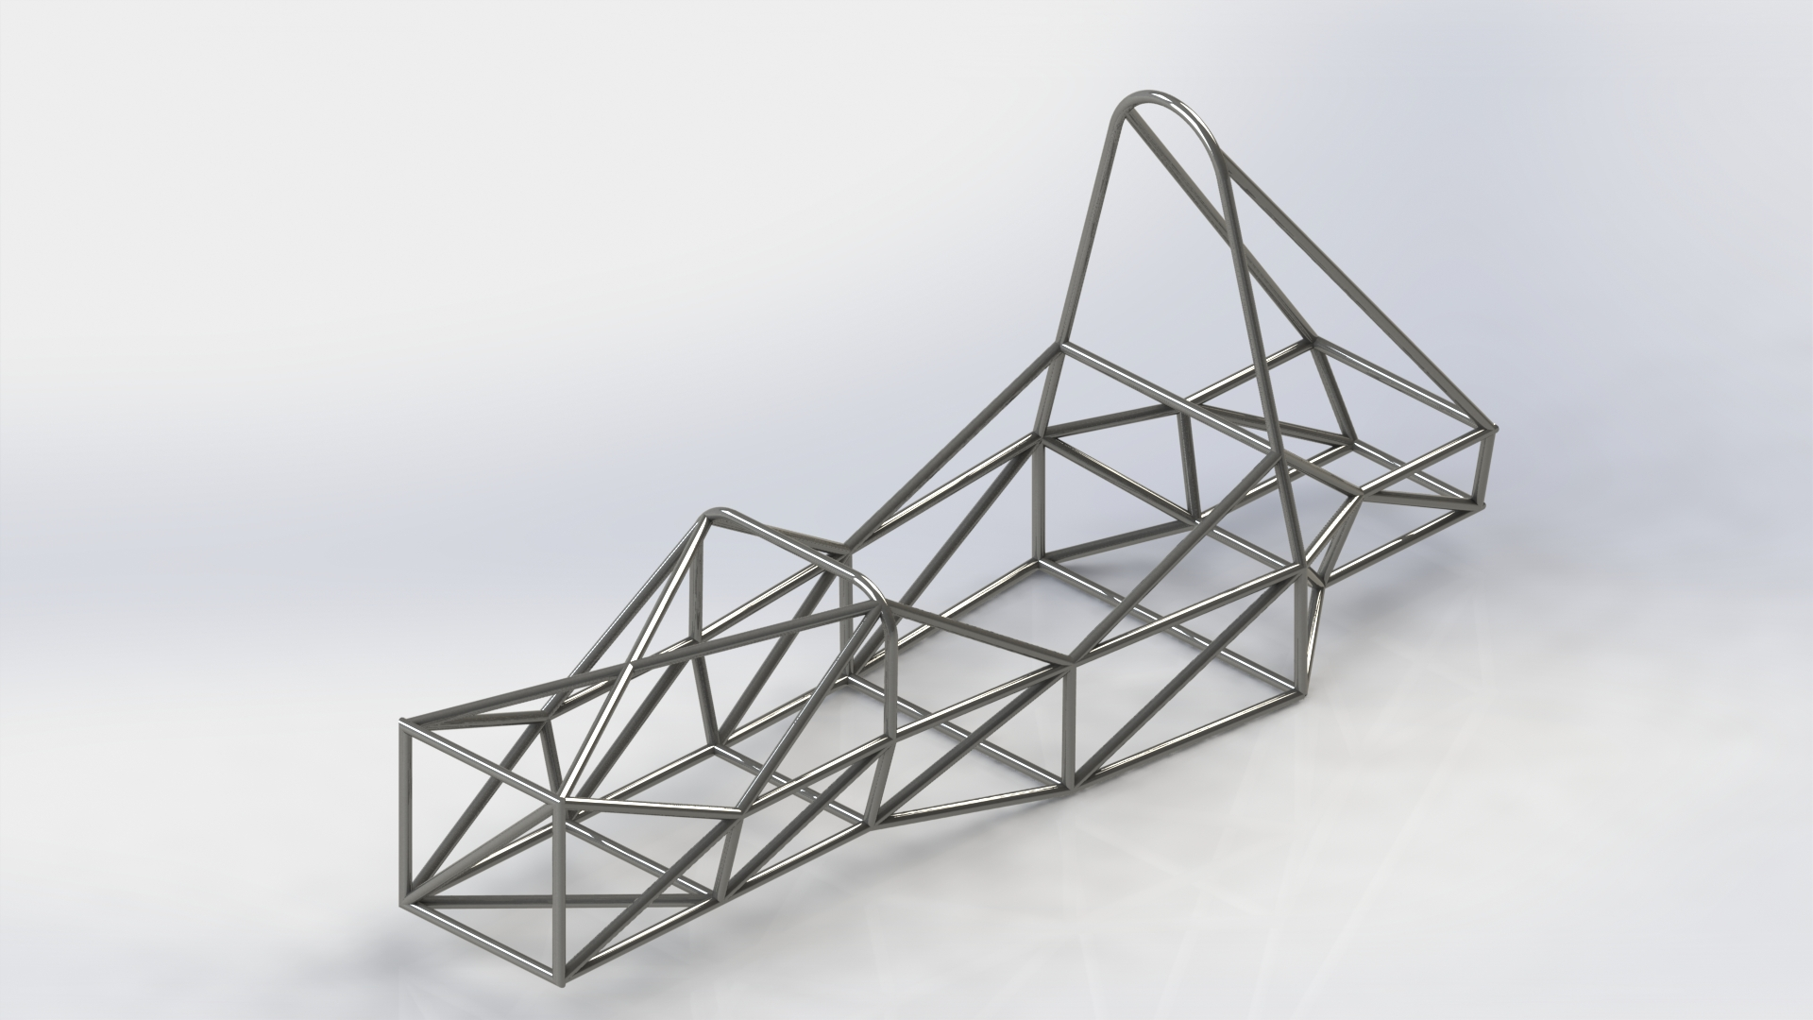
Mechanical
Drivetrain
Chassis
Handling
Suspension

Slide 9
Mechanical Design Process and Sub-Systems
We use SolidWorks and grabCAD (a place to keep all our team files in one place)
Drivetrain - System that delivers power to the driving wheels
Suspension - System of tires, tire air, springs, shock absorbers and linkages
Handling - Mechanical response to driver input
Chassis - Frame for the entire vehicle

Slide 10
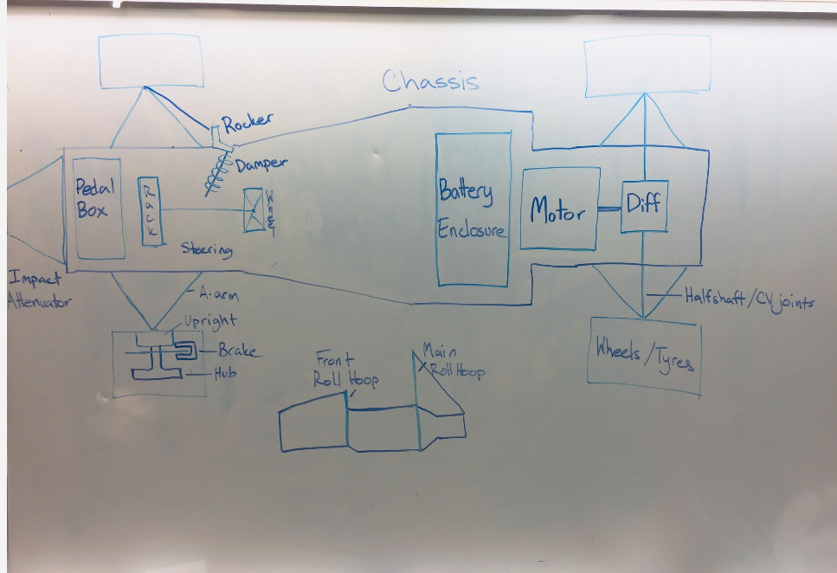
High Level Diagram
Suspension breakdown
Notes:
https://www.youtube.com/watch?v=XKscchk0HSE&feature=youtu.be

Slide 11
Activity: Find 2 kinds of technical inspection tests in the rules

Slide 12
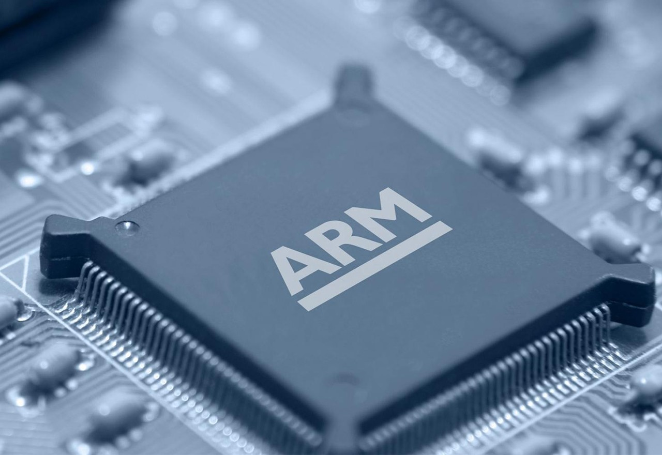
Embedded Team
Writing code to control a race car
Interfacing with motors, sensors
Multiple microcontroller
architecture
Real-time safety critical control

Slide 13
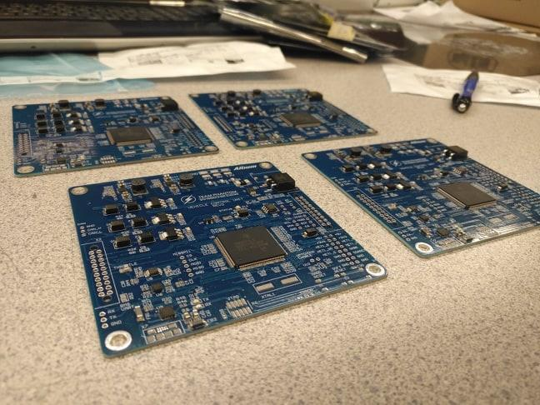
Embedded Systems
Iterative design process, lots of reviewing and testing
Coding - using language C and github
Run code on PCBs directly to run code and analyze response
Safety critical
Learn advanced microcontroller architecture
(This skill set is considered high in demand for software co-op jobs)

Slide 14
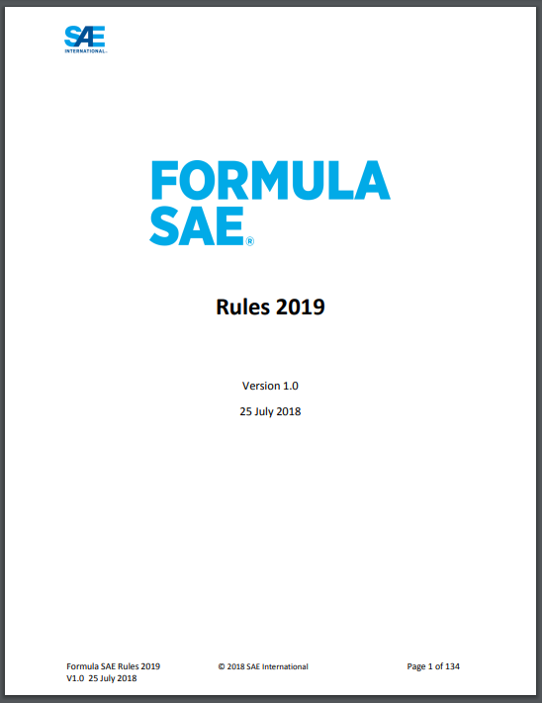
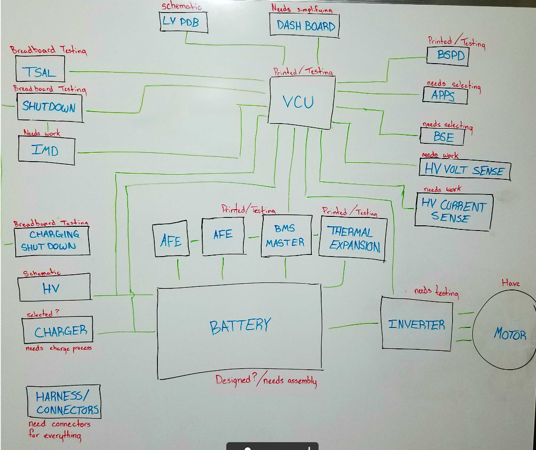
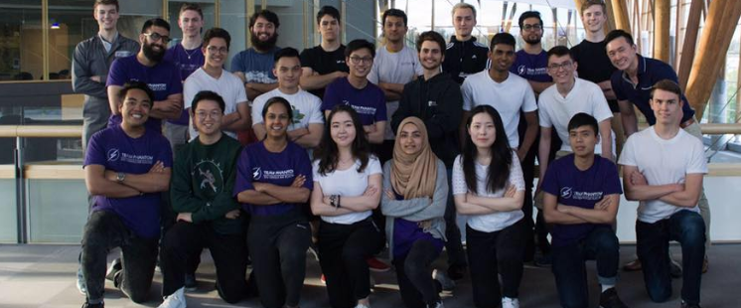
Takeaways
Get familiar with the competition rules
Engineers love acronyms, you will learn everything with time
Always ask questions! Phantom is about enjoying the learning experience and challenging yourself

